Slide 1
Simulating Liquid Crystals
Kit Gallagher
Supervisors: Prof Erika Eiser, Mr Jiaming Yu

Slide 2

Introduction
Introduction
Liquid Crystals
Entropically Driven Phase Transitions
Order Parameter & Onsager Theory
DNA as a Liquid Crystal
Methods
Rigid Rod Simulations
Nunchuck Simulations
Conclusions

Slide 3
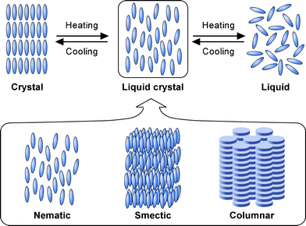
Liquid Crystals
Figure 1: Representation of the three liquid crystal phase classes, reproduced from Kato et al. [1] with permission. Note the distinct layers in the smectic and columnar phases, and the different class of molecule in the columnar phase.
[1] T. Kato, Y. Hirai, S. Nakaso, and M. Moriyama, Liquid-Crystalline Physical Gels, Chem. Soc. Rev. 36, 1857 (2007).

Slide 4
Phase Transitions
Lyotropic – Induced by changes in concentration
Entropically Driven – Occurring in the absence of attractive intermolecular forces

Slide 5
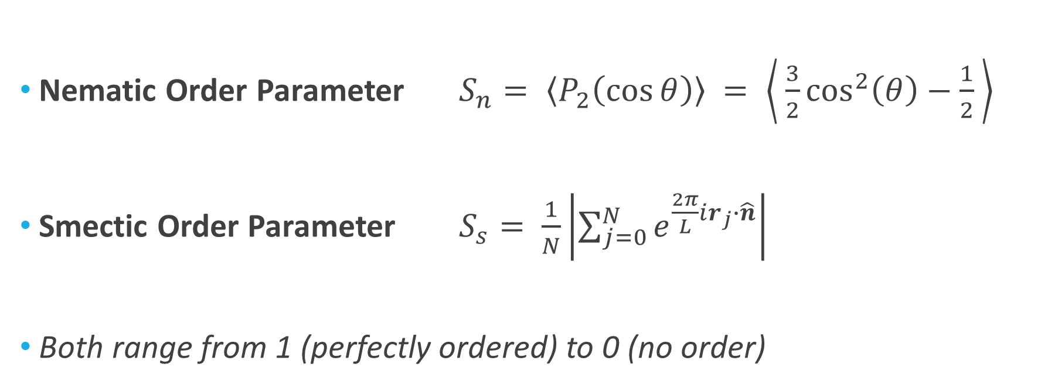
Order Parameter
Nematic Order Parameter $S_{n}= \left\langle P_{2}\left(\cos{θ}\right)\right\rangle = \left\langle \frac{3}{2}\cos^{2}\left(θ\right)−\frac{1}{2} \right\rangle$
Smectic Order Parameter $S_{s}= \frac{1}{N}\left|\sum_{j=0}^{N}{e^{\frac{2π}{L}ir_{j}∙\hat{n}}}\right|$
Both range from 1 (perfectly ordered) to 0 (no order)

Slide 6
DNA as a Liquid Crystal

Slide 7
Methods
Introduction
Methods
LAMMPS Software
Nunchuck Molecules
Rigid Rod Simulations
Nunchuck Simulations
Conclusions

Slide 8
Rigid Rod Simulations
Introduction
Methods
Rigid Rod Simulations
Nematic Transition
Smectic Transition
Nunchuck Simulations
Conclusions

Slide 9
Nunchuck Simulations
Introduction
Methods
Rigid Rod Simulations
Nunchuck Simulations
Fixed Rigidity
Fixed Angle
Dynamic Properties
Conclusions

Slide 10
Conclusions
Introduction
Methods
Rigid Rod Simulations
Nunchuck Simulations
Conclusions
Primary Findings
Further Work

Slide 11
References
¹ T. Kato, Y. Hirai, S. Nakaso, and M. Moriyama, Liquid-Crystalline Physical Gels, Chem. Soc. Rev. 36, 1857 (2007).

